Slide 1


Applications of Queue

Slide 2
Introduction
A queue is a linear data structure that follows the “first-in, first-out” (FIFO) principle. It is a collection of elements that supports two primary operations – Enqueue and Dequeue.
In the enqueue operation, an element is added to the back of the queue, while in the dequeue operation, an element is removed from the front of the queue.

Slide 3
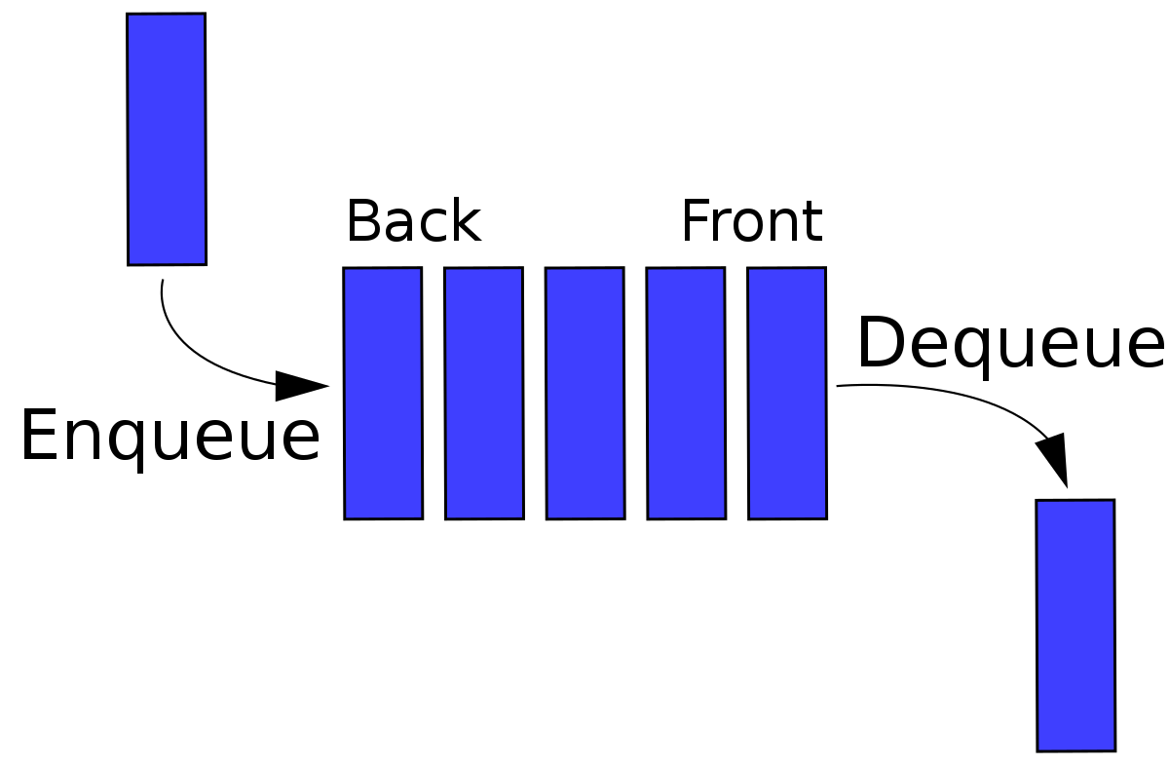
The basic operations of a queue include:
Enqueue: Add an element to the back of the queue.
Dequeue: Remove the element at the front of the queue.
Peek: Return the element at the front of the queue without removing it.
Size: Return the number of elements in the queue.
isEmpty: Check if the queue is empty.

Slide 4
Applications of Queue data structure
Task Scheduling: Queues can be used to schedule tasks based on priority or the order in which they were received.
Resource Allocation: Queues can be used to manage and allocate resources, such as printers or CPU processing time.
Message Buffering: Queues can be used to buffer messages in communication systems, such as message queues in messaging systems or buffers in computer networks.
Event Handling: Queues can be used to handle events in event-driven systems, such as GUI applications or simulation systems.

Slide 5
Traffic Management: Queues can be used to manage traffic flow in transportation systems, such as airport control systems or road networks.
Operating systems: Operating systems often use queues to manage processes and resources. For example, a process scheduler might use a queue to manage the order in which processes are executed.
Network protocols: Network protocols like TCP and UDP use queues to manage packets that are transmitted over the network. Queues can help to ensure that packets are delivered in the correct order and at the appropriate rate.

Slide 6
Printer queues :In printing systems, queues are used to manage the order in which print jobs are processed. Jobs are added to the queue as they are submitted, and the printer processes them in the order they were received.
Web servers: Web servers use queues to manage incoming requests from clients. Requests are added to the queue as they are received, and they are processed by the server in the order they were received.
Real world applications like Ticket counter, Restaurant
Asynchronous data transfer (Files input and output)

Slide 7
FCFS (FIRST-COME, FIRST-SERVED) Scheduling
FCFS is considered as simplest CPU-scheduling algorithm. In FCFS algorithm, the process that requests the CPU first is allocated in the CPU first. The implementation of FCFS algorithm is managed with FIFO (First in first out) queue.
Real Life Example Of FCFS Scheduling
As a real life example of FCFS scheduling a billing counter system of shopping mall can be observed. The first person in the line gets the bill done first and then the next person gets the chance to get the bill and make payment and so on.

Slide 8
FCFS Scheduling Mathematical Examples
Arrival time (AT) − Arrival time is the time at which the process arrives in ready queue.
Burst time (BT) or CPU time of the process − Burst time is the unit of time in which a particular process completes its execution.
Completion time (CT) − Completion time is the time at which the process has been terminated.
Turn-around time (TAT) − The total time from arrival time to completion time is known as turn-around time.

Slide 9
TAT can be written as,
Turn-around time (TAT) = Completion time (CT) – Arrival time (AT) or, TAT = Burst time (BT) + Waiting time (WT)
Waiting time (WT) − Waiting time is the time at which the process waits for its allocation while the previous process is in the CPU for execution. WT is written as,
Waiting time (WT) = Turn-around time (TAT) – Burst time (BT)
Response time (RT) − Response time is the time at which CPU has been allocated to a particular process first time.

Slide 10
Consider the given table below and find Completion time (CT), Turn-around time (TAT), Waiting time (WT), Response time (RT), Average Turn-around time and Average Waiting time.
Process ID | Arrival time | Burst time
P1 | 2 | 2
P2 | 5 | 6
P3 | 0 | 4
P4 | 0 | 7
P5 | 7 | 4

Slide 11
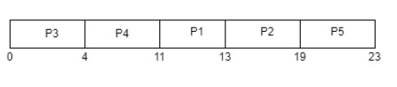
Gantt chart

Slide 12
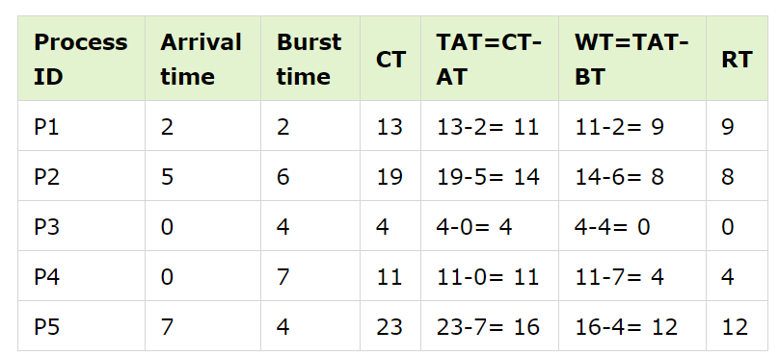

Slide 13
Average Waiting time = (9+8+0+4+12)/5 = 33/5 = 6.6 time unit (time unit can be considered as milliseconds)
Average Turn-around time = (11+14+4+11+16)/5 = 56/5 = 11.2 time unit (time unit can be considered as milliseconds)

